Slide 1

Building on Strengths

Slide 2





Slide 3


Slide 4


Slide 5
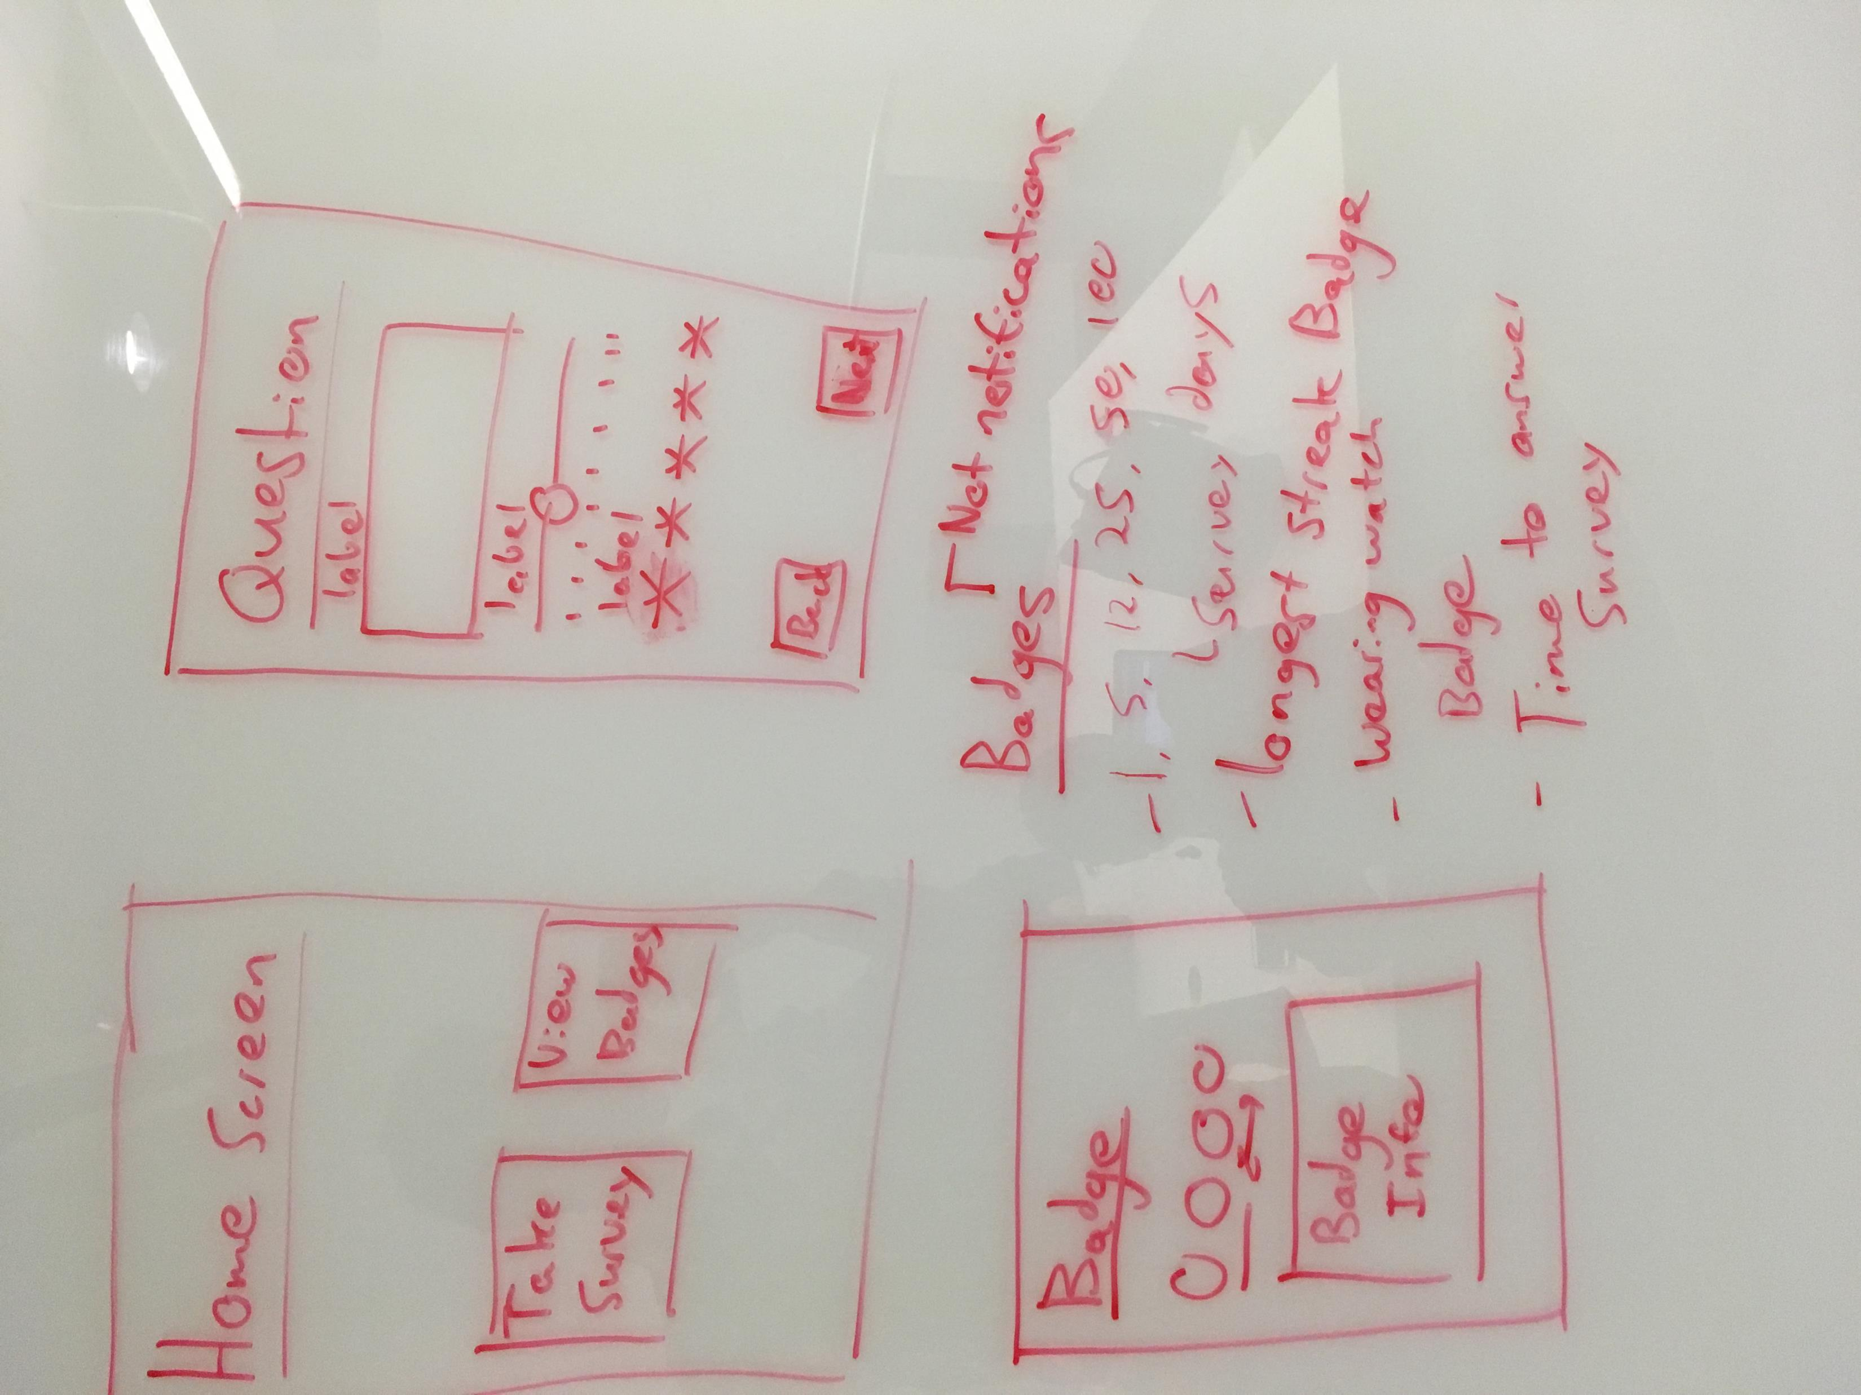
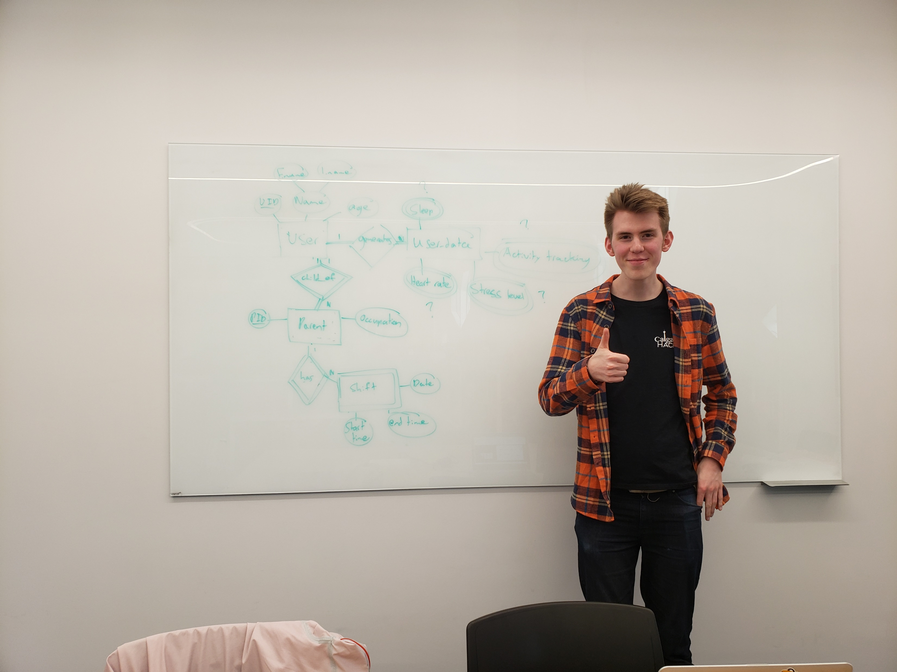
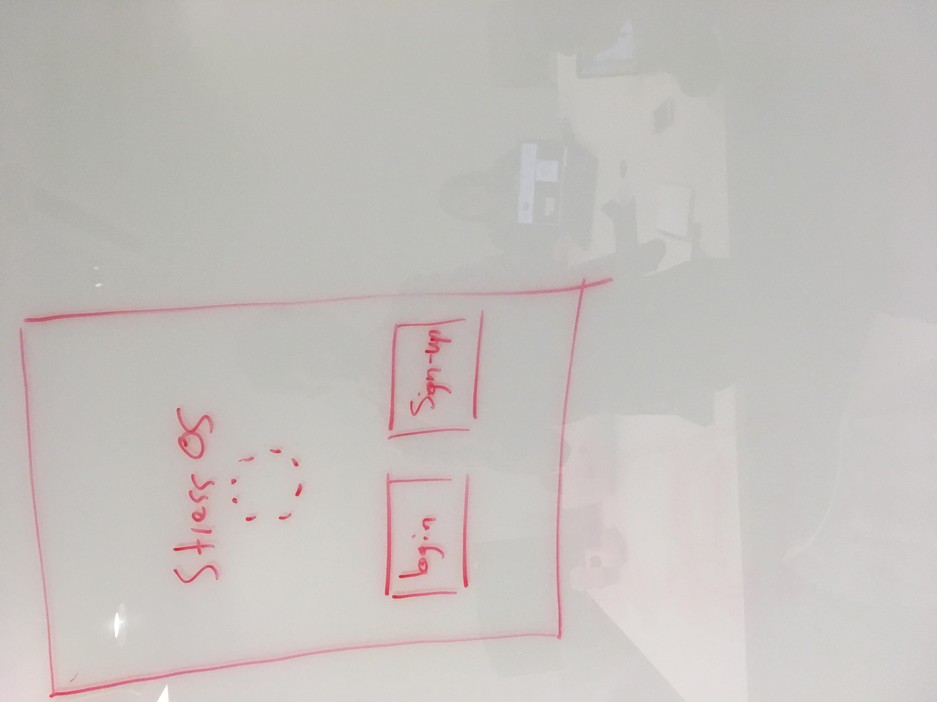

Slide 6



Slide 7


Slide 8



